Slide 1
Cloud Computing
SEWP ZG527
Notes:
RL 3.3

Slide 2


IaaS
Really, what is iaas???

Slide 3
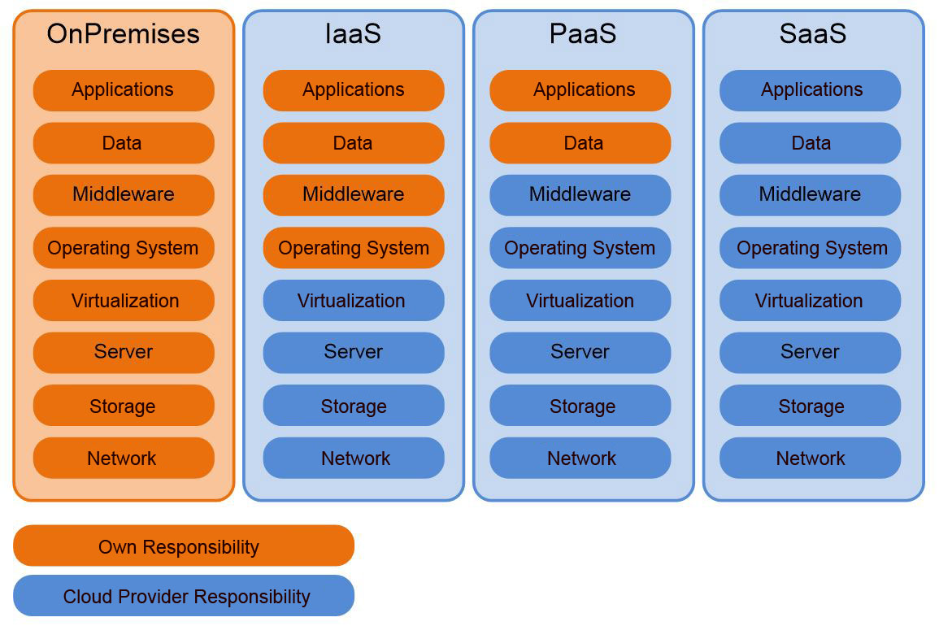
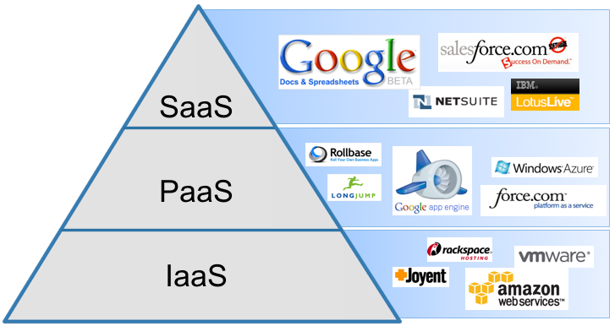
heard of 3 models of Cloud Computing?
Yes, Yes, IaaS, PaaS and SaaS

Slide 4
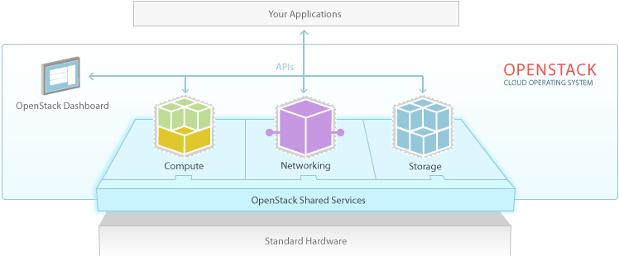
Openstack overview
OpenStack is a collection of open source technologies delivering a massively scalable cloud operating system.
OpenStack cloud operating system controls large pools of compute, storage, and networking resources throughout a datacenter, all managed through a dashboard that gives administrators control while empowering their users to provision resources through a web interface.

Slide 5
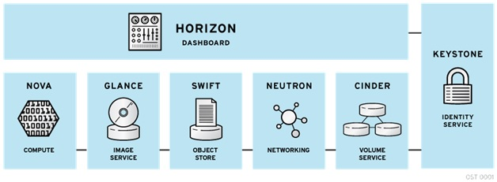
Openstack Components

Slide 6
Conceptual Architecture

Slide 7
Openstack Components. Cont.
Horizon – Dashboard
It provides a modular web-based user interface for all the OpenStack services. With this web GUI, you can perform most operations on your cloud like launching an instance, assigning IP addresses and setting access controls.

Slide 8
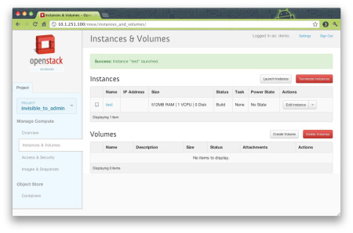
Horizon – Dashboard

Slide 9
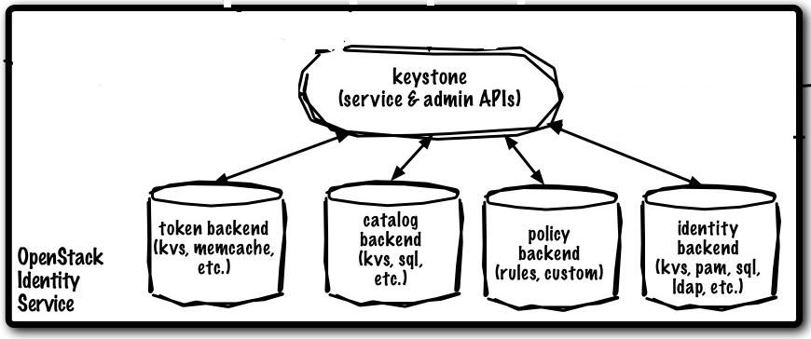
Keystone – Identity
Keystone is a framework for authentication and authorization for all the OpenStack services.
Keystone handles API requests as well as providing configurable catalog, policy, token and identity services.
It provides the ability to add users to groups (also known as tenants) and to manage permissions between users and groups. Permissions include the ability to launch and terminate instances.

Slide 10
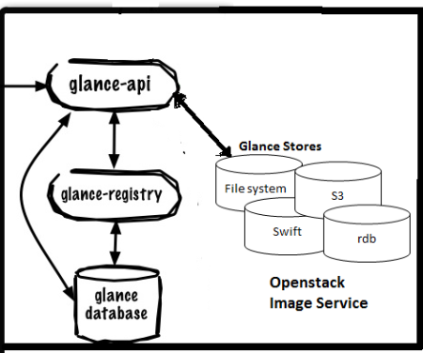
Glance – Image Store
It provides discovery, registration and delivery services for disk and server images. List of processes and their functions:
glance-api : It accepts Image API calls for image discovery, image retrieval and image storage.
glance-registry : it stores, processes and retrieves metadata about images (size, type, etc.).
glance database : A database to
store the image metadata.
A storage repository for the actual
image files. Glance supports
normal file-systems, Amazon S3,
and Swift.

Slide 11
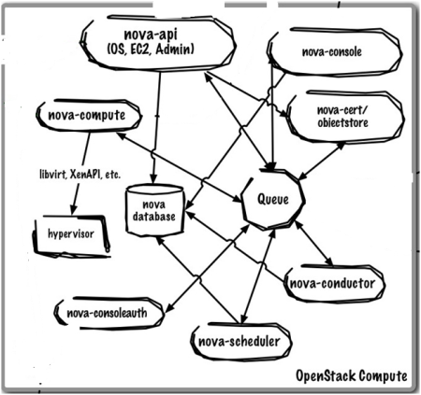
Nova – Compute
It provides virtual servers upon demand. Nova is the most complicated and distributed component of OpenStack. A large number of processes cooperate to turn end user API requests into running virtual machines.

Slide 12
Nova – Compute
nova-api : it’s a RESTful API web service which accepts incoming commands to interact with the OpenStack cloud.
nova-compute: it’s a worker daemon which creates and terminates virtual machine instances via Hypervisor’s APIs .
nova-scheduler: it takes a request from the queue and determines which compute server host it should run on.
nova-conductor: It provides services for nova-compute, such as completing database updates and handling long-running tasks.

Slide 13
Nova – Compute
nova database: It stores most of the build-time and run-time state for a cloud infrastructure.
The queue provides a central hub for passing messages between daemons. This is usually implemented with RabbitMQ.
Nova also provides console services to allow end users to access their virtual instance’s console through a proxy. This involves several daemons (nova-console, nova-novncproxy and nova-consoleauth).

Slide 14
Nova – Compute
nova-network : it’s a worker daemon very similar to nova-compute. It accepts networking tasks from the queue and then performs tasks to manipulate the network (such as setting up bridging interfaces or changing iptables rules). This functionality is being migrated to Quantum, a separate OpenStack service.
nova-volume : Manages creation, attaching and detaching of persistent volumes to compute instances. This functionality is being migrated to Cinder, a separate OpenStack service.

Slide 15
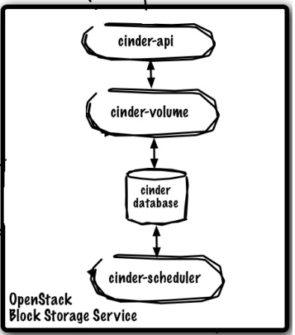
Cinder – Block Storage
Cinder allows block devices to be exposed and connected to compute instances for expanded storage & better performance.

Slide 16
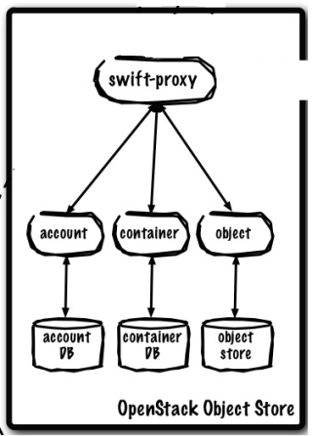
Swift – Object Storage
Object store allows you to store or retrieve files. It provides a fully distributed, API-accessible storage platform that can be integrated directly into applications or used for backup, archiving and data retention.
Note : Object Storage is not a traditional file system, but rather a distributed storage system for static data such as virtual machine images, photo storage, email storage, backups and archives.

Slide 17
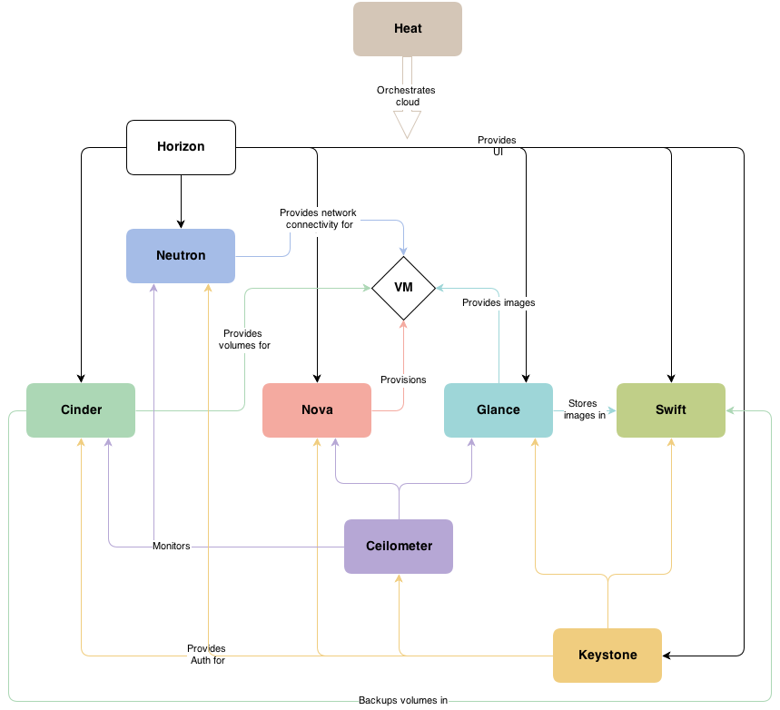
OpenStack conceptual architecture

Slide 18
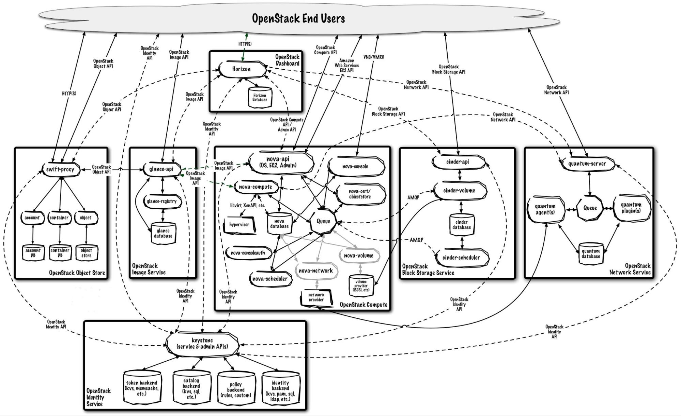

Slide 19
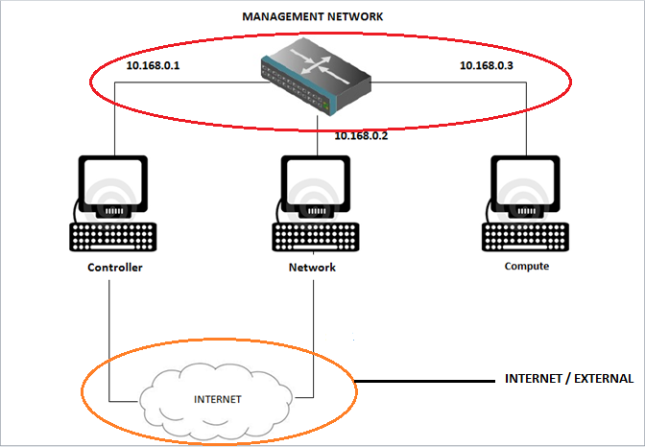
Networking
There are two networks :
Internal or Management network
External or
Internet
network

Slide 20
INTERNAL / MANAGEMENT NETWORK: → This network is present for internal connection between the machines. → The IP addresses for the network must be reachable only by the admin.
2. INTERNET / EXTERNAL NETWORK : → provides the VMs with internet access in some scenarios. → The IP addresses are reachable by anyone on the internet.
Note the IP addresses of the two networks. They are different.
The networks must be different from each other.
They are isolated from one another.

Slide 21
REASONS FOR CHOOSING THIS ARCHITECTURE
Clarity
Clear demarcation of roles
Ease of debugging
Easy to understand

Slide 22
CONTROLLER NODE
The controller is the central management system in a multinode cloud installation. Its main services include authentication and authorization ,and message queuing.

Slide 23
COMPONENTS OF CONTROLLER :
Databases(with MYSQL)
Queues(with Rabbit MQ)
Keystone
Glance
Nova(without nova-compute)
Cinder
Quantum Server(with OVS plugin)
Dashboard(with horizon)

Slide 24
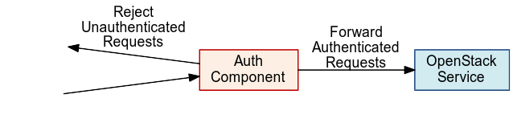
Keystone (OpenStack Identity Service):
The OpenStack Identity Service provides the cloud environment with an authentication and authorization system. In this system, users are a part of one or more projects. In each of these projects, they hold a specific role. Users need to have identity and a particular level of access in the cloud. When a user logs into the cloud, Keystone authenticates that he is indeed a user and authorises his level of access within the cloud.

